Slide 1
Evaluation Metrics CS229
Anand Avati

Slide 2
Topics
Why?
Binary classifiers
Rank view, Thresholding
Metrics
Confusion Matrix
Point metrics: Accuracy, Precision, Recall / Sensitivity, Specificity, F-score
Summary metrics: AU-ROC, AU-PRC, Log-loss.
Choosing Metrics
Class Imbalance
Failure scenarios for each metric
Multi-class
Notes:
Only math necessary: Counting and ratios!

Slide 3
Why are metrics important?
Training objective (cost function) is only a proxy for real world objective.
Metrics help capture a business goal into a quantitative target (not all errors are equal).
Helps organize ML team effort towards that target.
Generally in the form of improving that metric on the dev set.
Useful to quantify the “gap” between:
Desired performance and baseline (estimate effort initially).
Desired performance and current performance.
Measure progress over time (No Free Lunch Theorem).
Useful for lower level tasks and debugging (like diagnosing bias vs variance).
Ideally training objective should be the metric, but not always possible. Still, metrics are useful and important for evaluation.

Slide 4
Binary Classification
X is Input
Y is binary Output (0/1)
Model is ŷ = h(X)
Two types of models
Models that output a categorical class directly (K Nearest neighbor, Decision tree)
Models that output a real valued score (SVM, Logistic Regression)
Score could be margin (SVM), probability (LR, NN)
Need to pick a threshold
We focus on this type (the other type can be interpreted as an instance)

Slide 5
Score based models
Score = 1
 | Positive labelled example
 | Negative labelled example
#positives
#positives + #negatives
Prevalence =
Score = 0
Notes:
Dots are examples: Green = positive label, gray = negative label.
Consider score to be probability output of Logistic Regression.
Position of example on scoring line based on model output. For most of the metrics, only the relative rank / ordering of positive/negative matter.
Prevalence decides class imbalance.
If too many examples, plot class-wise histogram instead.
Rank view useful to start error analysis (start with the topmost negative example, or bottom-most positive example).

Slide 6
Score based models : Classifier
Label positive Label negative
Th
0.5
Th=0.5
Predict Negative Predict Positive
Notes:
Only after picking a threshold, we have a classifier.
Once we have a classifier, we can obtain all the Point metrics of that classifier.

Slide 7
Point metrics: Confusion Matrix
Label Positive Label Negative
9
2
Th
0.5
Th=0.5
Predict Negative Predict Positive
1
8
Notes:
All point metrics can be derived from the confusion matrix. Confusion matrix captures all the information about a classifier performance, but is not a scalar!
Properties:
Total Sum is Fixed (population).
Column Sums are Fixed (class-wise population).
Quality of model & selected threshold decide how columns are split into rows.
We want diagonals to be “heavy”, off diagonals to be “light”.

Slide 8
Point metrics: True Positives
Label positive Label negative
9
2
Th
0.5
TP
9
Th=0.5
Predict Negative Predict Positive
1
8
Notes:
TP = Green examples correctly identified as green.

Slide 9
Point metrics: True Negatives
Label positive Label negative
9
2
Th
0.5
TP
9
TN
8
Th=0.5
Predict Negative Predict Positive
1
8
Notes:
TN = Gray examples correctly identified as gray. “Trueness” is along the diagonal.

Slide 10
Point metrics: False Positives
Label positive Label negative
9
2
Th
0.5
TP
9
TN
8
FP
2
Th=0.5
Predict Negative Predict Positive
1
8
Notes:
FP = Gray examples falsely identified as green.

Slide 11
Point metrics: False Negatives
Label positive Label negative
9
2
Th
0.5
TP
9
TN
8
FP
2
FN
1
Th=0.5
Predict Negative Predict Positive
1
8
Notes:
FN = Green examples falsely identified as gray.

Slide 12
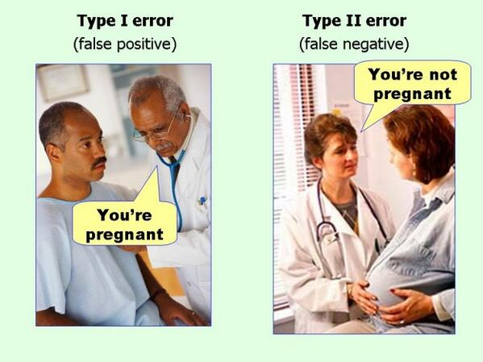
FP and FN also called Type-1 and Type-2 errors
Could not find true source of image to cite

Slide 13
Point metrics: Accuracy
Label positive Label negative
9
2
Th
0.5
TP
9
TN
8
FP
2
FN
1
Acc
.85
Th=0.5
Predict Negative Predict Positive
1
8
Notes:
Accuracy = what fraction of all predictions did we get right?
Improving accuracy is equivalent to having a 0-1 Loss function.

Slide 14
Point metrics: Precision
Label positive Label negative
9
2
Th
0.5
TP
9
TN
8
FP
2
FN
1
Acc
.85
Pr
.81
Th=0.5
Predict Negative Predict Positive
1
8
Notes:
Precision = quality of positive predictions.
Also called PPV (Positive Predictive Value).

Slide 15
Point metrics: Positive Recall (Sensitivity)
Label positive Label negative
9
2
Th
0.5
TP
9
TN
8
FP
2
FN
1
Acc
.85
Pr
.81
Recall
.9
Th=0.5
Predict Negative Predict Positive
1
8
Notes:
Recall (sensitivity) - What fraction of all greens did we pick out? Terminology from lab tests: how sensitive is the test in detecting disease?
Somewhat related to Precision ( both recall and precision involve TP)
Trivial 100% recall = pull everybody above the threshold.
Trivial 100% precision = push everybody below the threshold except 1 green on top (hopefully no gray above it!).
Striving for good precision with 100% recall = pulling up the lowest green as high as possible in the ranking.
Striving for good recall with 100% precision = pushing down the top most gray as low as possible in the ranking.

Slide 16
Point metrics: Negative Recall (Specificity)
Label positive Label negative
9
2
Th
0.5
TP
9
TN
8
FP
2
FN
1
Acc
.85
Pr
.81
Recall
.9
Spec
0.8
Th=0.5
Predict Negative Predict Positive
1
8
Notes:
Negative Recall (Specificity) - What fraction of all negatives in the population were we able to keep away?
Note: Sensitivity and specificity operate in different sub-universes.

Slide 17
Point metrics: F score
Label positive Label negative
9
2
Th
0.5
TP
9
TN
8
FP
2
FN
1
Acc
.85
Pr
.81
Recall
.9
Spec
.8
F1
.857
Th=0.5
Predict Negative Predict Positive
1
8
Notes:
Summarize precision and recall into single score
F1-score: Harmonic mean of PR and REC
G-score: Geometric mean of PR and REC

Slide 18
Point metrics: Changing threshold
Label positive Label negative
7
2
Th
0.6
TP
7
TN
8
FP
2
FN
3
Acc
.75
Pr
.77
Recall
.7
Spec
.8
F1
.733
Th=0.6
Predict Negative Predict Positive
3
8
Notes:
Changing the threshold can result in a new confusion matrix, and new values for some of the metrics.
Many threshold values are redundant (between two consecutively ranked examples). Number of effective thresholds = M + 1 (# of examples + 1)

Slide 19
Threshold Scanning
Threshold | TP | TN | FP | FN | Accuracy | Precision | Recall | Specificity | F1
1.00 | 0 | 10 | 0 | 10 | 0.50 | 1 | 0 | 1 | 0
0.95 | 1 | 10 | 0 | 9 | 0.55 | 1 | 0.1 | 1 | 0.182
0.90 | 2 | 10 | 0 | 8 | 0.60 | 1 | 0.2 | 1 | 0.333
0.85 | 2 | 9 | 1 | 8 | 0.55 | 0.667 | 0.2 | 0.9 | 0.308
0.80 | 3 | 9 | 1 | 7 | 0.60 | 0.750 | 0.3 | 0.9 | 0.429
0.75 | 4 | 9 | 1 | 6 | 0.65 | 0.800 | 0.4 | 0.9 | 0.533
0.70 | 5 | 9 | 1 | 5 | 0.70 | 0.833 | 0.5 | 0.9 | 0.625
0.65 | 5 | 8 | 2 | 5 | 0.65 | 0.714 | 0.5 | 0.8 | 0.588
0.60 | 6 | 8 | 2 | 4 | 0.70 | 0.750 | 0.6 | 0.8 | 0.667
0.55 | 7 | 8 | 2 | 3 | 0.75 | 0.778 | 0.7 | 0.8 | 0.737
0.50 | 8 | 8 | 2 | 2 | 0.80 | 0.800 | 0.8 | 0.8 | 0.800
0.45 | 9 | 8 | 2 | 1 | 0.85 | 0.818 | 0.9 | 0.8 | 0.857
0.40 | 9 | 7 | 3 | 1 | 0.80 | 0.750 | 0.9 | 0.7 | 0.818
0.35 | 9 | 6 | 4 | 1 | 0.75 | 0.692 | 0.9 | 0.6 | 0.783
0.30 | 9 | 5 | 5 | 1 | 0.70 | 0.643 | 0.9 | 0.5 | 0.750
0.25 | 9 | 4 | 6 | 1 | 0.65 | 0.600 | 0.9 | 0.4 | 0.720
0.20 | 9 | 3 | 7 | 1 | 0.60 | 0.562 | 0.9 | 0.3 | 0.692
0.15 | 9 | 2 | 8 | 1 | 0.55 | 0.529 | 0.9 | 0.2 | 0.667
0.10 | 9 | 1 | 9 | 1 | 0.50 | 0.500 | 0.9 | 0.1 | 0.643
0.05 | 10 | 1 | 9 | 0 | 0.55 | 0.526 | 1 | 0.1 | 0.690
0.00 | 10 | 0 | 10 | 0 | 0.50 | 0.500 | 1 | 0 | 0.667
Score = 1
Threshold = 1.00
Threshold = 0.00
Score = 0
Notes:
As we scan through all possible effective thresholds, we explore all the possible values the metrics can take on for the given model.
Each row is specific to the threshold.
Table is specific to the model (different model = different effective thresholds).
Observations: Sensitivity monotonic, Specificity monotonic in opposite direction. Precision somewhat correlated with specificity, and not monotonic. Tradeoff between Sensitivity and Specificity, Precision and Recall.

Slide 20
How to summarize the trade-off?
{Precision, Specificity} vs Recall/Sensitivity
Notes:
We may not want to pick a threshold up front, but still want to summarize the overall model performance.

Slide 21
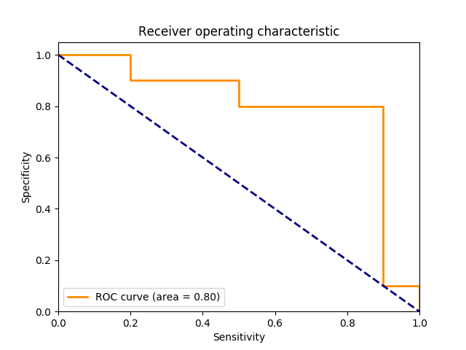
Summary metrics: ROC (rotated version)
Score = 1
Score = 0
Notes:
AUC = Area Under Curve. Also called C-Statistic (concordance score). Represents how well the results are ranked. If you pick a positive e.g by random, and negative e.g by random, AUC = probability that positive eg is ranked > negative example. Measure of quality of discrimination.
Some people plot TPR (= Sensitivity) vs FPR (= 1 - Specificity).
Thresholds are points on this curve. Each point represents one set of point metrics.
Diagonal line = random guessing.
Grid view (top left to bottom right, postive = move right, negative = move down)

Slide 22
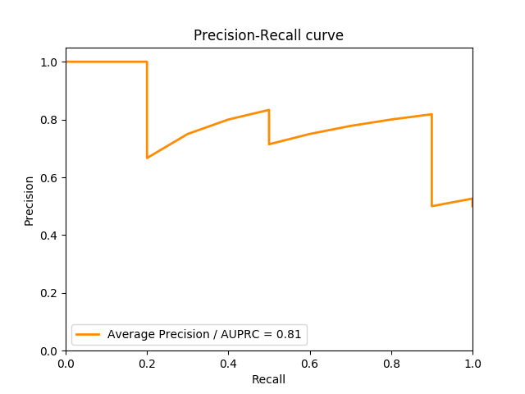
Summary metrics: PRC
Score = 1
Score = 0
Notes:
Precision Recall curve represents a different tradeoff. Think search engine results ranked.
End of curve at right cannot be lower than prevalence.
Area under PRC = Average Precision. Intuition: By randomly picking the threshold, what’s the expected precision?
While sensitivity monotonically decreased with increasing recall (the number of correctly classified negative examples can only go down), precision can be “jagged”. Getting a bunch of positives in the sequence increases both precision and recall (hence curve climbs up slowly), but getting a bunch of negatives in the sequence drops the precision without increasing recall. Hence, by definition, curve has only slow climbs and vertical drops.

Slide 23
Summary metrics: Log-Loss motivation
Score = 1
Score = 1
Model A
Model B
Score = 0
Score = 0
Two models scoring the same data set. Is one of them better than the other?
Notes:
Somehow the second model feels “better”.

Slide 24
Summary metrics: Log-Loss
These two model outputs have same ranking, and therefore the same AU-ROC, AU-PRC, accuracy!
Gain =
Log loss rewards confident correct answers and heavily penalizes confident wrong answers.
exp(E[log-loss]) is G.M. of gains, in [0,1].
One perfectly confident wrong prediction is fatal.
Gaining popularity as an evaluation metric (Kaggle)
Score = 1
Score = 1
Score = 0
Score = 0
Notes:
The metrics so far fail to capture this.
Accuracy optimizes for: Model gets $1 for correct answer, $0 for wrong.
Log-loss: Model makes a bet for $0.xy dollars that it’s prediction is correct. If correct, gets $0.xy dollars, else gets $(1-0.xy) dollar. Incentive structure is well suited to produce calibrated models. Take home is the GM of earned amounts.
Low-bar for exp(E[log-loss]) is 0.5
Log-loss on validation set measure how much did this “betting engine” earn.

Slide 25
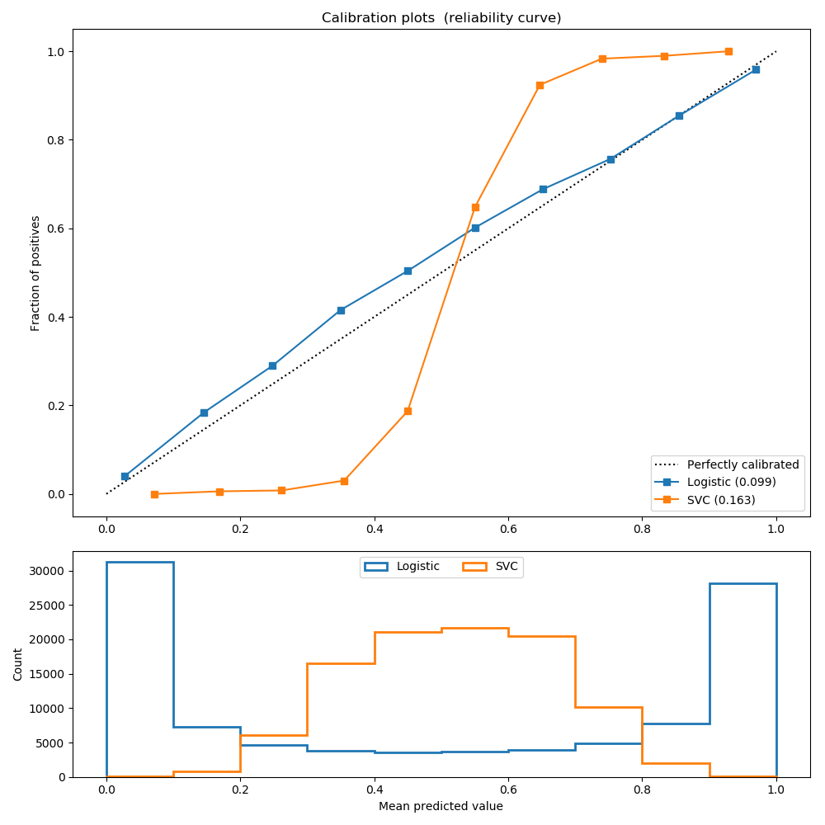
Calibration
Logistic (th=0.5):
Precision: 0.872
Recall: 0.851
F1: 0.862
Brier: 0.099
SVC (th=0.5):
Precision: 0.872
Recall: 0.852
F1: 0.862
Brier: 0.163
Brier = MSE(p, y)
Notes:
View calibration plot and histogram together
When model is well calibrated, then histogram indicates level of discrimination
If model is not calibrated, histogram may not mean much at all (see SVC plot)
Brier score is another measure of calibration. Both brier score and log-loss are Proper Scoring Rules.

Slide 26
Unsupervised Learning
logP(x) is a measure of fit in Probabilistic models (GMM, Factor Analysis)
High logP(x) on training set, but low logP(x) on test set is a measure of overfitting
Raw value of logP(x) hard to interpret in isolation
K-means is trickier (because of fixed covariance assumption)

Slide 27
Class Imbalance: Problems
Symptom: Prevalence < 5% (no strict definition)
Metrics: may not be meaningful.
Learning: may not focus on minority class examples at all (majority class can overwhelm logistic regression, to a lesser extent SVM)

Slide 28
Class Imbalance: Metrics (pathological cases)
Accuracy: Blindly predict majority class.
Log-Loss: Majority class can dominate the loss.
AUROC: Easy to keep AUC high by scoring most negatives very low.
AUPRC: Somewhat more robust than AUROC. But other challenges.
What kind of interpolation? AUCNPR?
In general: Accuracy << AUROC << AUPRC
Notes:
For accuracy, prevalence of majority class should be the low bar!
AUROC: 10% prevalence. top-10% are all negatives, next K are all positives, followed by rest of the negatives. AUPRC = 0.9 even though practically useless.

Slide 29
Multi-class (few remarks)
Confusion matrix will be NxN (still want heavy diagonals, light off-diagonals)
Most metrics (except accuracy) generally analysed as multiple 1-vs-many.
Multiclass variants of AUROC and AUPRC (micro vs macro averaging)
Class imbalance is common (both in absolute, and relative sense)
Cost sensitive learning techniques (also helps in Binary Imbalance)
Assign $$ value for each block in the confusion matrix, and incorporate those into the loss function.

Slide 30
Choosing Metrics
Some common patterns:
High precision is hard constraint, do best recall (e.g search engine results, grammar correction) -- intolerant to FP. Metric: Recall at Precision=XX%
High recall is hard constraint, do best precision (e.g medical diag). Intolerant to FN. Metric: Precision at Recall=100%
Capacity constrained (by K). Metric: Precision in top-K.
Etc.
Choose operating threshold based on above criteria.

Slide 31
Thank You!

